Slide 1
TITANIC DATA VISULIZATION
With Tableau Desktop
NAME : BEERAM PRAVEEN REDDY

Slide 2

Titanic dataset visulization
Source of dataset : Kaggle

Slide 3
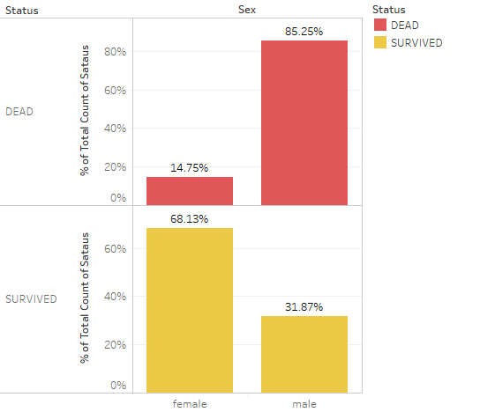
The Chart confirms Women more likely survivied than Men

Slide 4
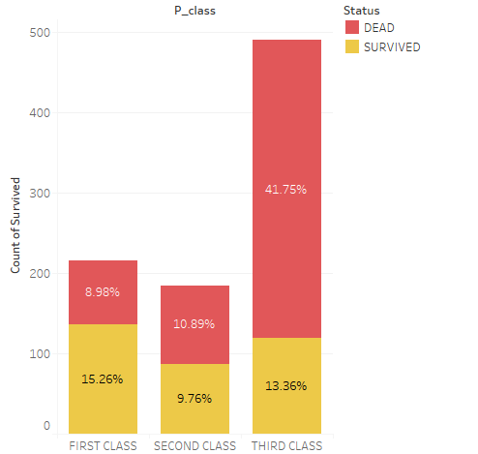
The chat visulization confirms that FIRST CLASS is more likely survived where THIRD CLASS more likely not survived.

Slide 5
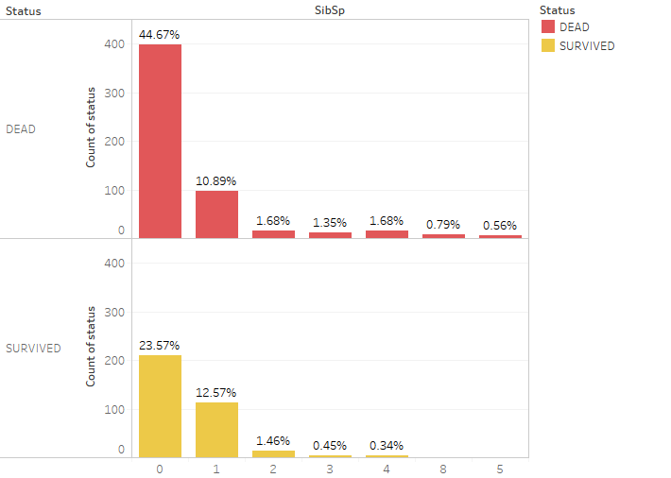
The Chart confirms a person aboarded without siblings or spouse more likely dead

Slide 6
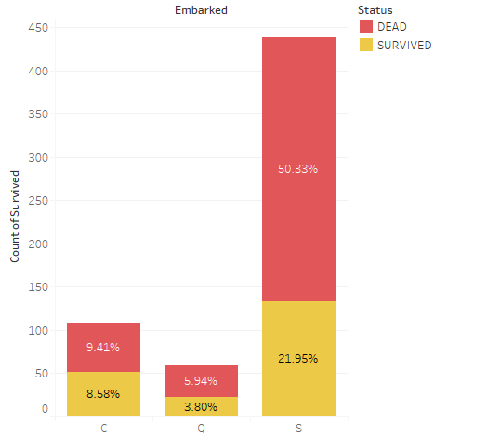
The Chart confirms a person aboarded from S more likely dead
The Chart is only for a person aboarded without siblings
C = Cherbourg
Q = Queenstown
S = Southampton

Slide 7
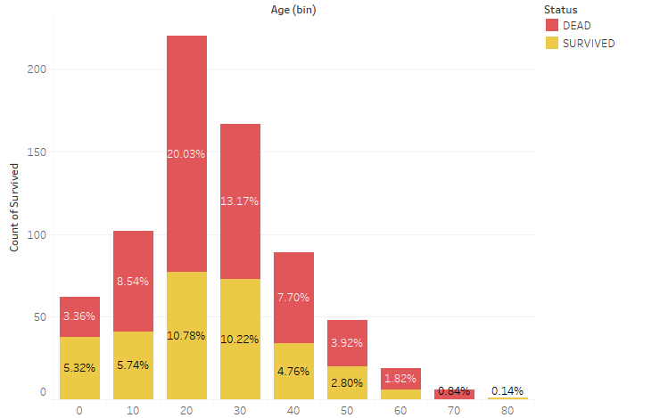
The Chart confirms that age group between 20-30 more likely dead
Bar Chart (Age Group)

Slide 8
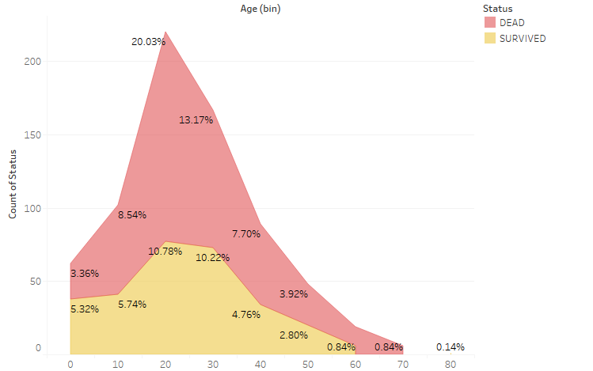
The line Chart confirms that age group between 20-30 more likely dead
Line Chart(Age Group)

Slide 9
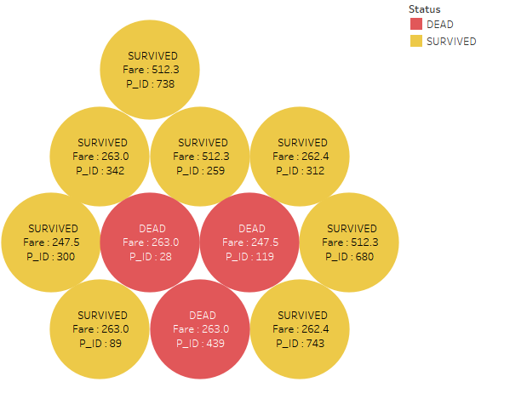
The packed bubble chart (Highest Fare)
The Chart confirms that the passengers with highest fare more likely survived

Slide 10
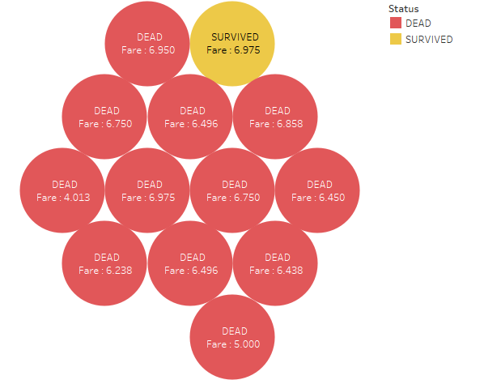
The packed bubble chart (Lowest Fare)
The Chart confirms that the passengers with lowest fare more likely dead

